Slide 1
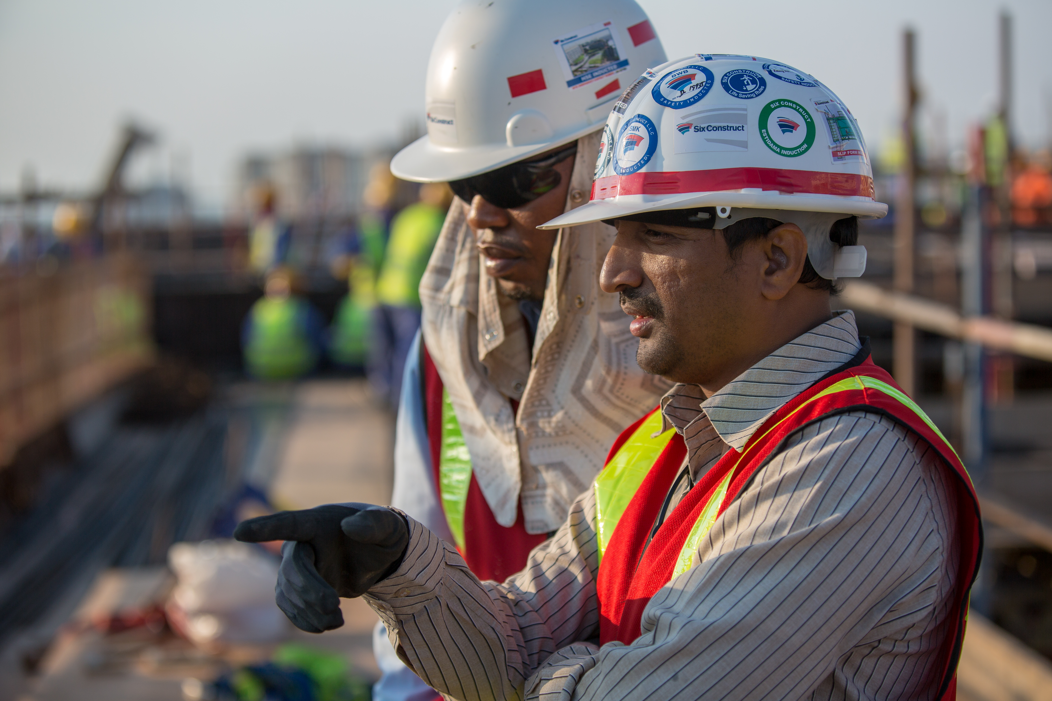
SUBCONTRACTOR ENGAGEMENT
GLOBAL SAFETY TIME OUT 2022
CLIMATE WORKSHOP

Slide 2
3 CHALLENGES
SYSTEMS
CLIMATE
MOTIVATION

Slide 3
3 CHALLENGES
SYSTEMS
CLIMATE
MOTIVATION

Slide 4
CLIMATE
Learning and speaking up

Slide 5
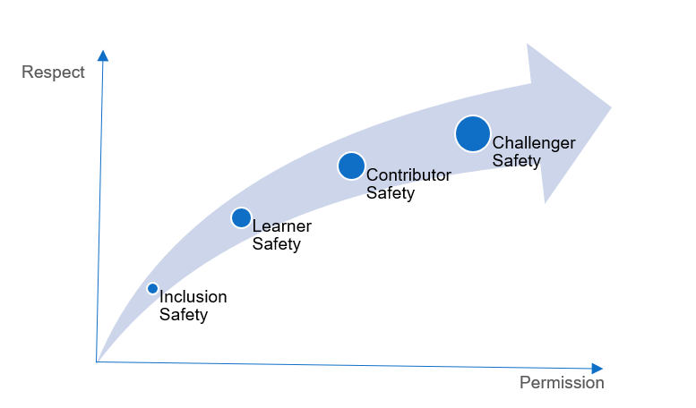
CLIMATE

Slide 6
CLIMATE
Inclusion safety
Respect as a team member
Permission to interact as a team member
Inclusion in exhange for absence of harm

Slide 7
CLIMATE
Learner safety
Respect for need to grow and learn
Permission to engage in learning
Encouragement in exchange for engagement

Slide 8
CLIMATE
Contributor safety
Respect for the ability to create value
Permission for guided autonomy
Autonomy in exchange for results

Slide 9
CLIMATE
Challenger safety
Respect for the ability to innovate
Permission to challenge the status quo
Cover in exchange for candor

Slide 10
CLIMATE

Slide 11
TIME FOR
questions, discussions, ideas

