Slide 1
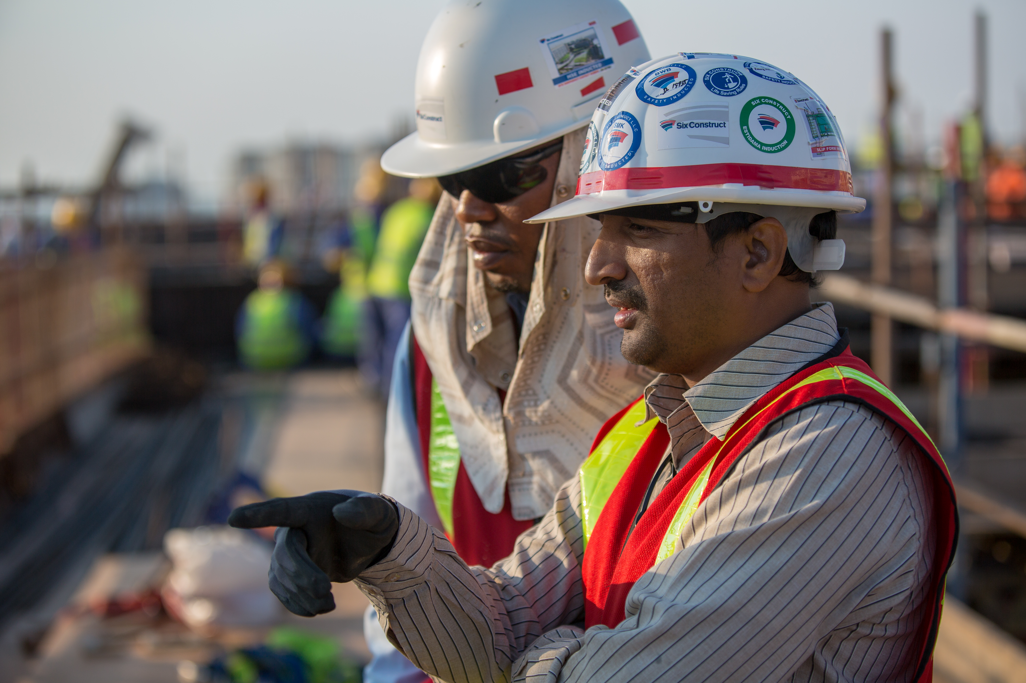
SUBCONTRACTOR ENGAGEMENT
GLOBAL SAFETY TIME OUT 2022
SYSTEMS WORKSHOP

Slide 2
3 CHALLENGES
SYSTEMS
CLIMATE
MOTIVATION

Slide 3
3 CHALLENGES
SYSTEMS
CLIMATE
MOTIVATION

Slide 4
SUBCONTRACTOR MANAGEMENT PROCESS
Pre-award
Needs
Subcontractors
Award
Communication
Execution
Supervision
Support
Post-execution
Negotiation
Evaluation
Lessons learned

Slide 5
SUBCONTRACTOR MANAGEMENT PROCESS
Leadership and participation
Planning
Support and Operation
Performance Evaluation
Improvement

Slide 6
SUBCONTRACTOR MANAGEMENT PROCESS
Leadership and participation
Planning
Support and Operation
Performance Evaluation
Improvement

Slide 7
TIME FOR
questions, discussions, ideas

