Slide 1
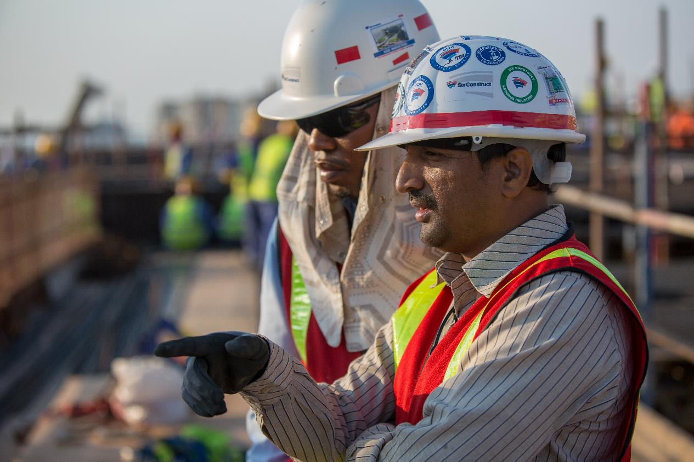
TOOLBOX
GLOBAL SAFETY TIME OUT
2022

Slide 3
QUESTION #1
What is “safe behavior”?

Slide 4
QUESTION #2
What are
the Life Saving Rules
that are applicable to
this project (or your
specific activity)?

Slide 5
QUESTION #2
Notes:
Delete the LSR picto’s which are not applicable

Slide 6
QUESTION #3
Is it always easy
or even possible to
follow them
at all times?

Slide 7
QUESTION #4
If you find yourself
in a situation where
it’s not possible to do so,
what should you do then?

Slide 8
QUESTION #5
How easy is it
to make a
stop work decision?

Slide 9
QUESTION #6
What would you need
to easily make
stop work decisions?

Slide 10
BONUS QUESTION
On this site, what is the
next accident we will have,
where will it happen
and why?

